Slide 1
ITCS 6162 Project
Action Rules Implementation
This is a Group Project. Locate your Group Members on Moodle.*
Prepare 6 power point slides on the subject of Rule Extraction and Action Rules.
Find a youtube.com video (or another video) on the subject of Rule Extraction (in Data Mining).
Implement Action Rules extraction algorithm - ARoGS (see slides 6-9). Compute the support and confidence of the action rules.
To turn in: upload the PowerPoint file, the video link file, and the implementation source code files to Moodle | click on Group Project. One group member ONLY should upload the project.
* Note:
This is a Group Project . On Moodle locate your Group Members , and obtain their e-mails . This project requires that every student checks his/her UNCC e-mail account, and communicates with his / her group-mates . Contact your group-mates as soon as possible . Be sure to talk to them , meet with them , e-mail , telephone , Facebook or use any other means of communication you like . If a student is reported by his / her group-mates as non-responsive or not participating in the group activities , the student will receive a grade of 0 for this project .

Slide 2
ITCS 6162 Project
Action Rules Implementation
For input to the program , choose one dataset from :
http://archive.ics.uci.edu/ml/datasets.html
to download use http://mlearn.ics.uci.edu/MLSummary.html
Input should be: 2 flat text files (as downloaded from the link) . 1st file .data - program should handle comma “ , “ delimited and tab “ “ delimited data formats . 2nd file .names - containing attribute names each on a new line .
Test program with at least 3 different datasets from this link
(should work with BOTH categorical and numerical attribute types (all attribute types))
We will test your program with a random data sample from the link above . Program should not crash , hang (freeze) , or take more than 3 minutes (180 seconds) to complete . Keep implementation SIMPLE .
Program should NOT generate DUPLICATE rules . Add a module to the program to check for duplicates , and remove them , before producing the output .
Program should produce an Output File (flat text), which contains all the output Action Rules extracted, including support and confidence for each rule .
Interface: should allow to OPEN a dataset file (flat text file) | allow user to specify support and confidence tresholds | display all attribute names and allow user to specify stable and flexible attributes | allow user to specify DECISION attribute, display all values of decision attribute and allow user to specify desired class – for example: decision D change from d1 -> d2 | display all Action Rules produced

Slide 3
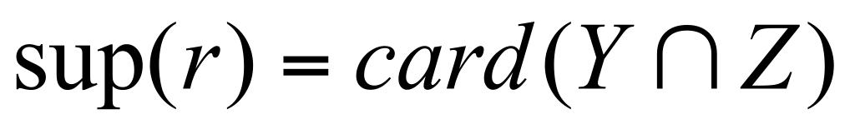
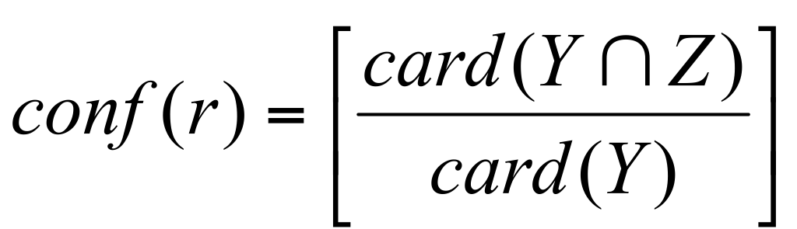
ARED – Object Based
Action Rule Discovery
(a, a₁ → a₁)
(a, a₂ → a₂)
(b, b₁ → b₁)
(b, b₂ → b₂)
………..
(d, d₁ → d₁)
(d, d₂ → d₂)
(a, a2) * (b, b1) Y = {x₂, x₄}
(d, d1) Z = {x₁,x₂,x₃,x₄,x₅,x₇}
Decision System S
atomic action terms
X | a | b | c | d
x₁ | a₁ | b₁ | c₁ | d₁
x₂ | a₂ | b₁ | c₂ | d₁
x₃ | a₂ | b₂ | c₂ | d₁
x₄ | a₂ | b₁ | c₁ | d₁
x₅ | a₂ | b₃ | c₂ | d₁
x₆ | a₁ | b₁ | c₂ | d₂
x₇ | a₁ | b₂ | c₂ | d₁
x₈ | a₁ | b₂ | c₁ | d₃
r=[(a, a₂ → a₂)*(b, b₁ → b₁)] → (d, d₁ → d₁)
(w, w) ∈ (Y, Y ) → (w,w) ∈ (Z, Z)
action rule
Support:
Confidence:
sup(r) = 2
conf(r) = 2/2 = 1

Slide 4
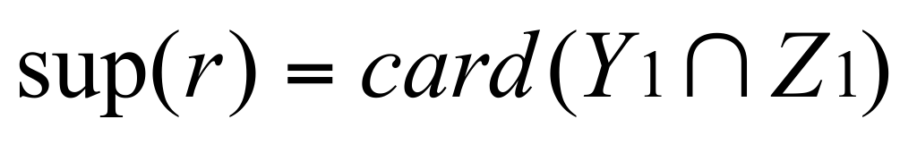
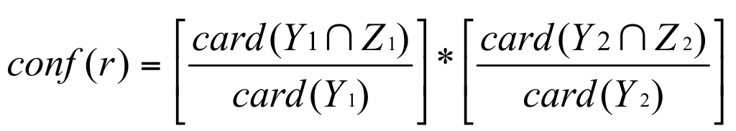
(a, a₁ → a₁)
(a, a₁ → a₂)
(b, b₁ → b₂)
(b, b₂ → b₂)
………..
(d, d₁ → d₁)
(d, d₂ → d₂)
atomic action terms
Decision System S
X | a | b | c | d
x₁ | a₁ | b₁ | c₁ | d₁
x₂ | a₂ | b₁ | c₂ | d₁
x₃ | a₂ | b₂ | c₂ | d₁
x₄ | a₂ | b₁ | c₁ | d₁
x₅ | a₂ | b₃ | c₂ | d₁
x₆ | a₁ | b₁ | c₂ | d₂
x₇ | a₁ | b₂ | c₂ | d₁
x₈ | a₁ | b₂ | c₁ | d₃
r=[(a, a₂ → a₁)*(b, b₁ → b₁)] → (d, d₁ → d₂)
(Y₁, Y ₂) (Z₁, Z₂)
sup(r) = 2
conf(r) = 1/2
rule
Y₁ = {x₂, x₄}
Z₁ = {x₁,x₂,x₃,x₄,x₅,x₇}
Y₂ = {x₁, x₆}
Z₂ = { x₆}

Slide 5
(a, a₁ → a₁)
(a, a₁ → a₂)
(b, b₁ → b₂)
(b, b₂ → b₂)
………..
(d, d₁ → d₁)
(d, d₂ → d₂)
atomic terms
Decision System S
X | a | b | c | d
x₁ | a₁ | b₁ | c₁ | d₁
x₂ | a₂ | b₁ | c₂ | d₁
x₃ | a₂ | b₂ | c₂ | d₁
x₄ | a₂ | b₁ | c₁ | d₁
x₅ | a₂ | b₃ | c₂ | d₁
x₆ | a₁ | b₁ | c₂ | d₂
x₇ | a₁ | b₂ | c₂ | d₁
x₈ | a₁ | b₂ | c₁ | d₃
r=[(a, a₂ → a₁)*(b, b₁ → b₁)] → (d, d₁ → d₂)
(Y₁, Y ₂) (Z₁, Z₂)
sup(r) = 1
conf(r) = 1/2
rule
Y₁ = {x₂, x₄}
Z₁ = {x₁,x₂,x₃,x₄,x₅,x₇}
Y₂ = {x₁, x₆}
Z₂ = { x₆}

Slide 6
ARoGS - Action Rules Discovery
Decision table S = (U, A_{Fl} ∪ A_{St} ∪ {d}).
Assumption: {a₁,a₂,...,a_{p}} ⊆ A_{St}, {b₁,b₂,...,b_{q}} ⊆ A_{Fl},
a_{i,1}∈ Dom(a_{i}), b_{i,1}∈ Dom(b_{i}).
Rule:
r = [a_{1,1} ∧ a_{2,1} ∧ ... ∧ a_{p,1} ] ∧ [b_{1,1} ∧ b_{2,1} ∧ ... ∧ b_{q,1}] → d₁
stable part flexible part
Action rule schema r_{[d2 → d1]} associated with r and
re-classification task (d, d₂ → d₁):
[a_{1,1} ∧ a_{2,1} ∧ ... ∧ a_{p,1}] ∧
[(b₁, → b_{1,1} )∧ (b₂, → b_{2,1})∧ ... ∧ (b_{q}, → b_{q,1})] → (d, d₂ → d₁)

Slide 7
ARoGS - Action Rules Discovery
X | a | b | c | e | f | g | d
x1 | a1 | b1 | c1 | e1 | f2 | g1 | d1
x2 | a2 | b1 | c2 | e2 | f2 | g2 | d3
x3 | a3 | b1 | c1 | e2 | f2 | g3 | d2
x4 | a1 | b1 | c2 | e2 | f2 | g1 | d2
x5 | a1 | b2 | c1 | e3 | f2 | g1 | d2
x6 | a2 | b1 | c1 | e2 | f3 | g1 | d2
x7 | a2 | b3 | c2 | e2 | f2 | g2 | d2
x8 | a2 | b1 | c1 | e3 | f2 | g3 | d2
Decision System S
a, b, c – stable
e, f, g - flexible
Goal: reclassify objects in S from class d₂ to d₁.

Slide 8
Step 1: extract all rules , which imply → d1 (have d1 on the right side) by using LERS algorithm .
For each rule r : {
Step 2. generate r_{[d2 → d1]} (action rule schema) by:
r1 = [b₁ ∧ c₁ ∧ f₂ ∧ g₁] → d₁
r1_{[d2 → d1]} = [b₁ ∧ c₁ ∧ (f, → f₂) ∧ (g, → g₁)] → (d, d₂ → d₁)
b₁ ∧ c_{1 – stable} f₂ ∧ g_{1 – flexible} (f, → f₂) means change f from anything to f₂
Step 3. compute set of objects supporting the schema r_{[d2 → d1]}
U_{[r1,d2]} = Sup(r1_{[d2 → d1]}) = {x₃, x₆, x₈}
Step 4. take the header (stable attributes i.e. b₁ ∧ c₁ ) from r_{[d2 → d1]} and combine with all remaining attribute values . Mark the subsets of U_{[r1,d2]}
[b₁ ∧ c₁ ∧ a₁]∗ = {x₁} ⊄ U_{[r1,d2]}
[b₁ ∧ c₁ ∧ a₂]∗ = {x₆, x₈} ⊆ U_{[r1,d2]} marked
[b₁ ∧ c₁ ∧ a₃]∗ = {x₃} ⊆ U_{[r1,d2]} marked
[b₁ ∧ c₁ ∧ f₃]∗ = {x₆} ⊆ U_{[r1,d2]} marked
[b₁ ∧ c₁ ∧ g₃]∗ = {x₃,x₈} ⊆ U_{[r1,d2]} marked

Slide 9
Step 5
From marked generate action rules by using r1_{[d2 → d1]}
Action Rules:
[b₁ ∧ c₁ ∧ a₂ ∧ (f, → f₂) ∧ (g, → g₁)] → (d, d₂ → d₁),
[b₁ ∧ c₁ ∧ a₃ ∧ (f, → f₂) ∧ (g, → g₁)] → (d, d₂ → d₁),
[b₁ ∧ c₁ ∧ (f, f₃ → f₂) ∧ (g, → g₁)] → (d, d₂ → d₁),
[b₁ ∧ c₁ ∧ (f, → f₂) ∧ (g, g₃ → g₁)] → (d, d₂ → d₁)
}

